Slide 1
Programming Fundamentals I
Week 7 Searching and sorting

Slide 2
Agenda
Linear search
Binary search
Selection sort
Bubble sort

Slide 3
WARNING: Code uses exclusive upper bounds
To comply with Python convention, we use inclusive lower bounds and exclusive upper bounds in all example code here

Slide 4
Searching
Looking for that item

Slide 5
Searching
One of the most fundamental problems in programming is to find one or more items that match a certain criteria from a bunch of items
Absolute criteria
Find the record of a person named ‘Pete’
Find a list of items whose price is higher than 100 baht
Relative criteria
Find a point whose coordinate is closest to the origin
Find out who got the highest score

Slide 6
We discuss two search algorithms with absolute criteria
Linear search
Binary search

Slide 7
Linear search: Intuition
Look at each element sequentially and compare if it is equal to the search item

Slide 8
Linear search: Demo
Given this list:
lst = [8, 2, 11, 13, 1, 5, 4, 7]
Let’s work through it together!
Find 5
Find 10

Slide 9
Linear search: Code
def linear_search(lst, v):
for i in range(len(lst)):
if v == lst[i]:
return i
return None

Slide 10
Linear search: Discussion
The algorithm takes time proportional to the number of elements in the worst case
For non-preprocessed, unsorted generic data, this is the best we can do
In some cases, we can do better
Data already sorted
Preprocessed data, containing some kind of indexing structures

Slide 11
Binary search: Intuition
Only works for sorted list
Look at the middle element of the list
If it is equal to the search item:
End the search
If it is smaller than the search item, the first half are all smaller:
Discard the first half
If it is larger than the search item, the second half are all larger:
Discard the second half
Repeat until we find the item or the list becomes empty

Slide 12
Binary search: Demo
Given this list:
lst = [1, 2, 4, 5, 7, 8, 11, 13]
Let’s work through it together!
Find 5
Find 13
Find 10

Slide 13
Recursive binary search: Code
def binary_search_r(lst, v, i=0, j=None):
if j == None:
j = len(lst)
if i >= j:
return None
mid = (i+j) // 2
if v < lst[mid]:
return binary_search_r(lst, v, i, mid)
elif v > lst[mid]:
return binary_search_r(lst, v, mid+1, j)
else:
return mid

Slide 14
Iterative binary search: Code
def binary_search_i(lst, v):
i, j = 0, len(lst)
while i < j:
mid = (i+j) // 2
if v < lst[mid]:
j = mid
elif v > lst[mid]:
i = mid + 1
else:
return mid
return None

Slide 15
Binary search: Discussion
Let’s look at the worst-case running time – the case where the searched item is not in the list
For a 1-element list, it takes 1 try to know if the item is not in the list
For a 2-element list, how many tries does it take?
What about a 4-element list?
What about an 8-, a 16-, a 32-element list, and so on?
Why?
For a list of n = 2^{k} elements, it takes at most k + 1 tries
For simplicity, we assume always discarding exactly half of the list
For any list of n elements, it takes at most k + 1 = log₂ n + 1 tries

Slide 16
Sorting
Ranking a bunch of items

Slide 17
Sorting
Another one of the most fundamental programming problems is to reorder items with regard to some of their properties
Direct properties
Student scores
Names in alphabetical order
People based on their date of birth
Derived properties
Coordinates based on computed distance from a reference point
DNA sequences based on pairwise distance from a given DNA sequence

Slide 18
We look into simple sorting algorithms today
Selection sort
Bubble sort

Slide 19
Selection sort: Intuition
Find the smallest element and swap it with the front element
Now that the front element is the smallest:
We repeat the process with the rest of the elements
After each round of repetition, the first i^{th} elements are sorted

Slide 20
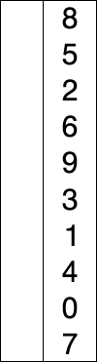
Selection sort: Demo

Slide 21
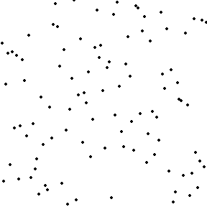
Selection sort: Visualization
Check out Wikipedia for a slower (better) version of the animation

Slide 22
First, let’s find where the smallest element is
def argmin(lst, i, j):
min_idx = i
for k in range(i+1, j):
if lst[k] < lst[min_idx]:
min_idx = k
return min_idx

Slide 23
Now, sort them with the selection sort
def selection_sort(lst):
n = len(lst)
for i in range(n-1):
min_idx = argmin(lst, i, n)
lst[i], lst[min_idx] = lst[min_idx], lst[i]

Slide 24
Selection sort: Discussion
Requires looking for minimum on every iteration
Takes time proportional to the number of elements
And it takes N-1 iterations to complete
In total it takes a quadratic number of comparisons

Slide 25
Bubble sort: Intuition
What happens when we compare each consecutive pair:
Starting from the leftmost one
Moving up one position each time
Swapping the pair if the left element is larger than the right element
What would the rightmost element be?

Slide 26
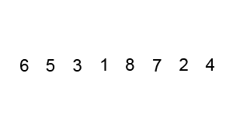
Bubble sort: Demo

Slide 27
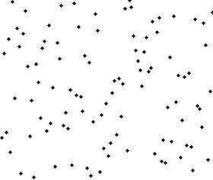
Bubble sort: Visualization
Check out Wikipedia for a slower (better) version of the animation

Slide 28
Let’s look at the code
def bubble_sort_v1(lst):
n = len(lst)
for i in range(n-1):
for j in range(n-1):
if lst[j] > lst[j+1]:
lst[j], lst[j+1] = lst[j+1], lst[j]

Slide 29
We can reduce the number of iterations
def bubble_sort_v2(lst):
n = len(lst)
for i in range(n-1):
for j in range(n-i-1):
if lst[j] > lst[j+1]:
lst[j], lst[j+1] = lst[j+1], lst[j]

Slide 30
Bubble sort: Discussion
Quadratic time in all cases
Can be further improved
Check to terminate when there are no swaps in the previous round
Improvement: Linear time in an already sorted list
Simple, but not a very efficient sorting algorithm

Slide 31
Now we look for early termination opportunity
def bubble_sort_v3(lst):
n = len(lst)
for i in range(n-1):
swapped = False
for j in range(n-i-1):
if lst[j] > lst[j+1]:
lst[j], lst[j+1] = lst[j+1], lst[j]
swapped = True
if not swapped:
break

Slide 32
Are there better sorting algorithms?
Yes!
Those are based on divide-and-conquer technique which is one of the recursive techniques
We will learn two of them later (in other courses)
Merge sort
Quick sort
However, these non-recursive algorithms we learn today are still useful in many cases
Simpler code
Performs well on small lists

Slide 33
References
All images are from Wikipedia

